Slide 1
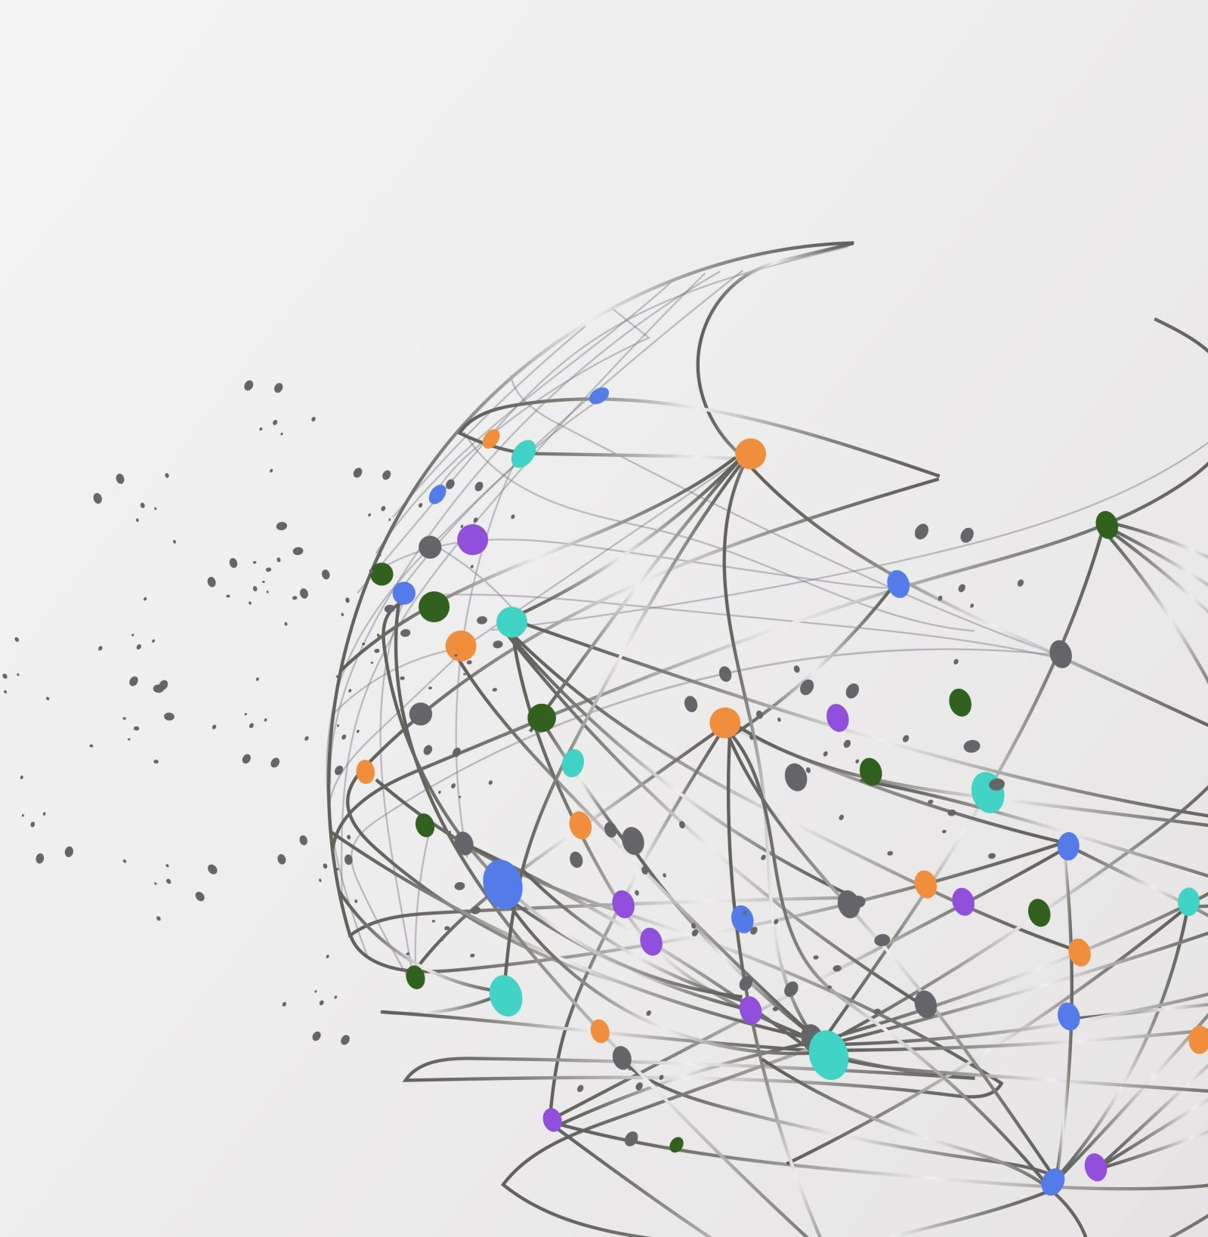
Social Network Analysis Of Physicians.
TEAM MEMBERS:
Rohith Reddy Poreddy
Gopi Cherukuri
Sai Prasanth
Sumanth
Krithika Reddy

Slide 2
Introduction
In healthcare, it's customary for doctors to issue written orders referring patients to other healthcare providers.
Referrals are essential to ensure patients receive appropriate care.
Here, we explore a social network where each node represents a physician, and edges signify referrals to other physicians.

Slide 3

Problem Statement
How can we quantify the level of connectedness or influence held by each physician?
Additionally, we aim to identify the most highly connected physician and groups of physicians who refer to each other frequently.

Slide 4

Dataset & Technologies
Dataset: https://networkrepository.com/soc-physicians.php
This dataset portrays a social network of physicians, featuring 241 physicians and 1,098 relationships.
Technologies: Python, Networkx, pandas library, Matplotlib, Jupyter Notebook.
Notes:
Here in this network, physicians are nodes and referrals are edges.
The technologies we have used are python, network, pandas, matplotlib.
Language – python
Libraries – pandas, matplotlib
IDE – Jupyter Notebook
Pandas – It is used for data manipulation. Most of you somewhere or other have used dataframes in pandas.
Matplotlib is used for good visualizations.

Slide 5

Algorithms
We employ the following algorithms:
1) Centrality Analysis:
Degree Centrality
Betweenness Centrality
2) Community Detection Algorithms
Notes:
There are many algorithms in social network analysis but then these are the major algorithms which we used:
Centrality analysis : It is set of measures used to identify the most important nodes in a network.
Nodes are represented individually such as websites or other units.
Edges represent connections and relations between them.
These centrality measures are useful in various applications, such as social network analysis, transportation network analysis, and communication network analysis.
Selecting of centrality measure depends on the specific characteristics and goals of the network being analyzed.
Most common measures are
1. Degree centrality
2. Betweeness centrality

Slide 6
Degree Centrality
Degree centrality is a measure used in graph theory to quantify the importance or centrality of a node within a network.
Degree centrality provides insights into the popularity or prominence of individuals based on the number of connections they have.
Each individual is represented as a node, and connections between individuals are represented as edges.
Nodes with a high degree centrality are considered central or influential in the network.
Notes:
Degree Centrality: It is one of the simplest measure. It depends on number of links and edges a node has. Each individual is represented as a node, and connections between individuals are represented as edges. Nodes with a high degree centrality are considered central or influential in the network.

Slide 7

Betweenness Centrality
It quantifies the extent to which a node serves as a bridge or intermediary between other nodes in a network.
Nodes with high betweenness centrality play a crucial role in maintaining connectivity and facilitating communication between different parts of the network.

Slide 8

Outcome
We achieved:
Enhanced visualization of physician groups.
Identification of the most connected physician.
Identification of the physician most frequently referred to.

Slide 9
Thank You

